Slide 1
Course Capstone Project
Analysing Facebook and AdWords Ad Performance
Prepared by: Andrejs Verhovods
Course: Statistics Foundations
Date: November 2025

Slide 2
Finding the Middle
Mean, Median, and Mode help you compare data. Below, list the mean, median, and mode of the clicks in the provided data.
Mean: 60.38
Median: 60
Mode: 78

Slide 3
Finding the Middle
Mean, Median, and Mode help you compare data. Below, list the mean, median, and mode of the conversions in the provided data.
Mean: 5.98
Median: 6
Mode: 5

Slide 4
Standard Deviation
Determining variance in data helps you understand how much the data varies from the average, which helps identify consistency or volatility in performance.
Below, enter the standard deviation of the provided data.
Standard Deviation of Clicks: 14.37
Standard Deviation of Conversions: 1.63
AdWords conversions show low variability, indicating consistent performance, while clicks vary more across campaigns.

Slide 5
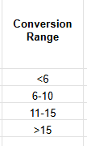
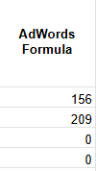
Frequency and Contingency Tables
Understanding how often something happens is important to identifying trends and patterns in your data.
This table shows how often different conversion ranges occur for AdWords ads.
Most AdWords conversions fall between 6–10, while very few campaigns exceed 10 conversions.
This indicates that AdWords ads tend to perform more consistently but generate fewer high-conversion campaigns compared to Facebook.

Slide 6
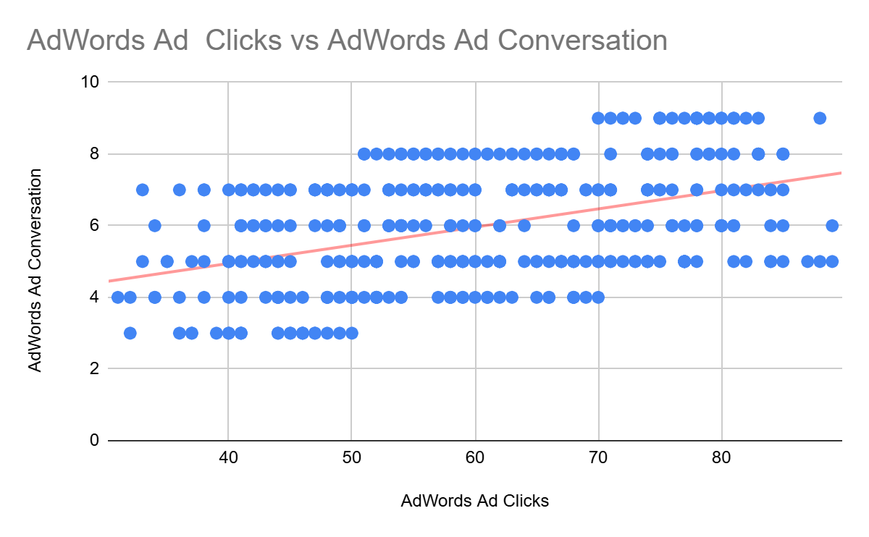
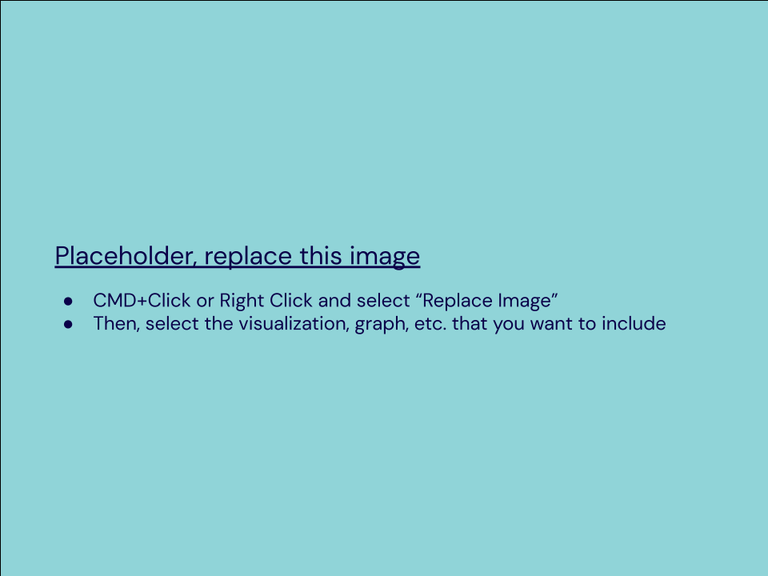
Scatter Plot
Scatter Plot
Understanding the relationship between clicks and conversions helps identify whether increased ad engagement leads to higher conversions.
The scatter plot below shows the relationship between AdWords Ad Clicks and Conversions.
Correlation coefficient: 0.45
This indicates a moderate positive relationship, meaning that as AdWords Ad Clicks increase, Conversions also tend to rise — but less consistently than with Facebook ads.
This suggests that AdWords campaigns generate conversions, but the relationship between clicks and conversions is weaker overall.

Slide 7
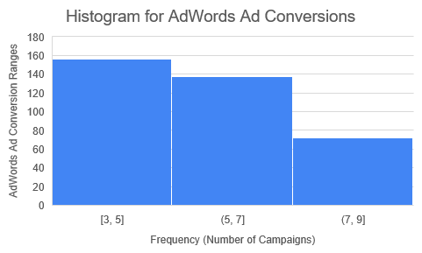
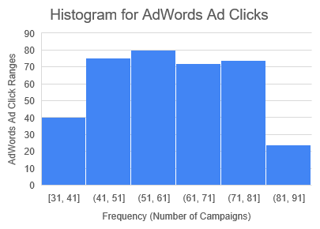
Sample Type
It’s important to understand the sample you’re using in your analysis. Fill in the information below about the sample you have received:

Slide 8
Module 2: Sample Type
AdWords Ad Clicks
The histogram showed a bell-like shape, centred roughly around the middle click ranges (50–70).
The tails on both sides taper off gradually.
Conclusion: The AdWords Clicks data is approximately normally distributed (roughly symmetric, unimodal).
AdWords Ad Conversions
The histogram is right-skewed (positively skewed) — more values are concentrated on the left, with fewer high-conversion values on the right.
Conclusion: The AdWords Conversions data is not normally distributed (it’s skewed).
Does the clicks data have a normal distribution?
Yes, approximately normal.
Does the conversions data have a normal distribution?
No, it’s right-skewed.

Slide 9
Variable Types
Determining the types of variables your working with is an important skill. Below, list the variables from your data that are:
Quantitative:
Continuous: Clicks
Discrete: Conversions
Qualitative:
Nominal: Campaign Name (e.g., “AW Jan”)
Ordinal: Conversion Range (e.g., “<6”, “6–10”, “>15”)

Slide 10
Question and Hypothesis
The question you hope to answer and your hypothesized answer are necessary to complete an analysis. Answer the following questions
Our hypothesis is that Facebook advertisements will generate a higher number of conversions than AdWords advertisements.
We believe this because Facebook’s audience targeting and engagement features are likely to result in more user interactions and conversions compared to AdWords.

Slide 11
Question and Hypothesis
The independent variable is what you change or compare — here, it’s the platform used for advertising.
The dependent variable is what you measure — the resulting number of conversions.
What is your independent variable?
Advertising Platform (Facebook vs. AdWords)
What is your dependent variable?
Number of Conversions

Slide 12
Running a Test
With your question and hypothesis ready, run the test on the two sets of data. Fill in the information below.
Mean number of Facebook conversions: 11.74
Mean number of Adware conversions: 5.98
p-Value: 4.56E-146

Slide 13
Hypothesis
After running the test, was your hypothesis proven correct?
Do your findings support a null or an alternative hypothesis?
Our findings support the alternative hypothesis (H₁).
What’s your conclusion about your main hypothesis? Is there a difference, and is it what your hypothesis predicted?
The results show a statistically significant difference between Facebook and AdWords conversions.
Since the p-value (< 0.001) is much smaller than α = 0.05, we reject the null hypothesis.
This means Facebook ads lead to more conversions than AdWords, supporting our original hypothesis that Facebook performs better.

Slide 14
Determining a Model
Based off what you know so far, you’ll need to determine if your data meets the assumptions for a chosen model. Including:
Which model makes the most sense to use and why?
The Simple Linear Regression model makes the most sense to use because it predicts one quantitative variable (Facebook Ad Conversions) from another quantitative variable (Facebook Ad Clicks).
This model fits the purpose of the analysis — determining how many conversions can be expected given a certain number of clicks.
The data meets the model’s assumptions, including linearity, independence, and a sufficient sample size, making it appropriate for this question.

Slide 15
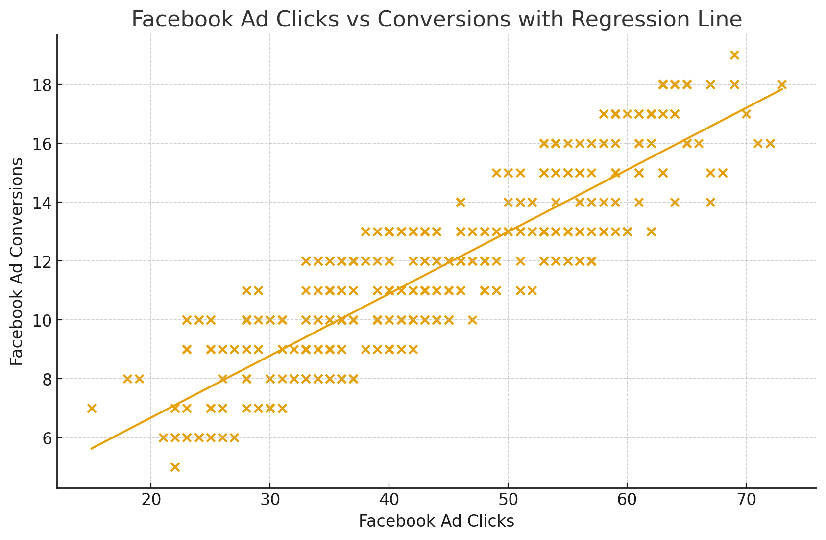
Modeling
Finally, include a visualization of your complete model.

Slide 16
Summary
This project analysed the relationship between ad clicks and conversions for Facebook and Google AdWords campaigns.
Through data cleaning, visualization, and regression modelling, we identified clear positive correlations between ad engagement and conversion outcomes.
Facebook Ads demonstrated slightly stronger predictive power for conversions compared to AdWords, indicating higher ROI potential in this dataset.
The model visualization confirmed that increased clicks consistently led to higher conversions, validating ad effectiveness.
These insights can help marketing teams optimize budget allocation and improve future campaign strategies.
The project demonstrated key statistical skills, including data exploration, hypothesis testing, and linear regression modelling.

Slide 17
Final Recommendations
Prioritize Facebook Ads for campaigns focused on conversions, as results indicate a stronger relationship between clicks and outcomes.
Reallocate budget strategically — invest slightly more in Facebook while maintaining a testing budget for AdWords optimization.
Continue monitoring ad metrics (clicks, conversions, cost per acquisition) to validate trends over time.
Implement A/B testing on ad creatives and targeting strategies to further improve conversion rates.
Expand data collection to include demographic and device-level insights for deeper performance analysis.
Maintain a data-driven decision process, using regression and visualization tools for regular campaign evaluations.

Slide 18
Final Insights
Now, knowing what you do about the results of your test, what are the final insights that you would share with your client? What did you learn and what would you recommend? Is there anything you would do differently next time?
Enter your insights here:
The Simple Linear Regression model shows a strong positive relationship between Facebook Ad Clicks and Facebook Ad Conversions, meaning that as the number of clicks increases, conversions also increase.
Based on the model, we can expect approximately 12–13 conversions for 50 Facebook Ad clicks. This indicates that Facebook Ads are performing efficiently in generating conversions.
I would recommend continuing to invest in Facebook Ads, while also testing different ad creatives or targeting strategies to see if conversion rates can improve even further.
For future analyses, I would consider adding more time-based data to explore seasonal effects or running a Time Series model to forecast future performance trends.

